Slide 1
E-bazar.net Marketplace
Back-end Dev. : Madikhan Sadykov
Mobile Dev. : Nurbolat Nurzhanov
Front-end Dev. : Abdul-Madi Erkanat

Slide 2
Short description about E-bazar.net
This is simple marketplace where was placed products for example clothes with its prices and reviews and photos. This market allows you sign in / sign up and add products to cart and make an order.

Slide 3
Goals
a
Develop a web version of the store
b
Develop a mobile version of the store
c
Gain teamwork experience
d
Use agile methodology

Slide 4
About us
Team and roles

Slide 5
Madikhan Sadykov
Our team MNM
Back-end Developer (Node.js, Mongo.db)
Nurbolat Nurzhanov
Mobile Developer (Flutter, Dart)
Madi Erkanat
Front-end Developer
(Html, CSS, JavaScript)

Slide 6
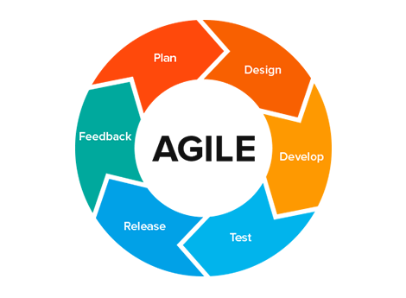
Methodology (Agile)

Slide 7
MVP
Registration and login via account
Search for any type of product
Adding or saving a product in your account
Adding an item to the cart
Buy product

Slide 8
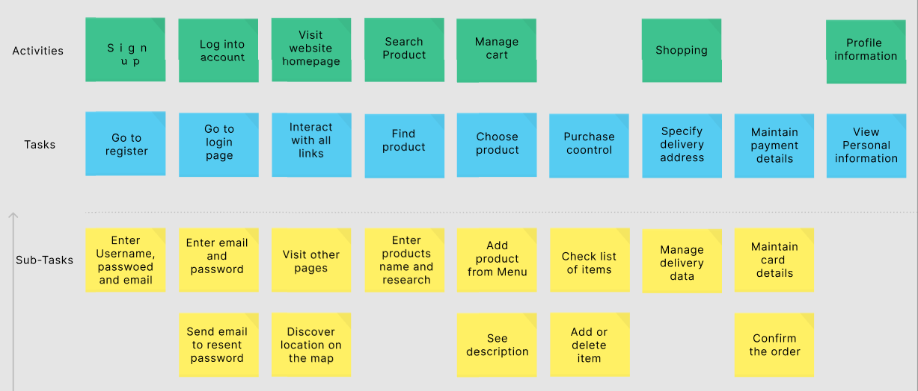
User stories

Slide 9
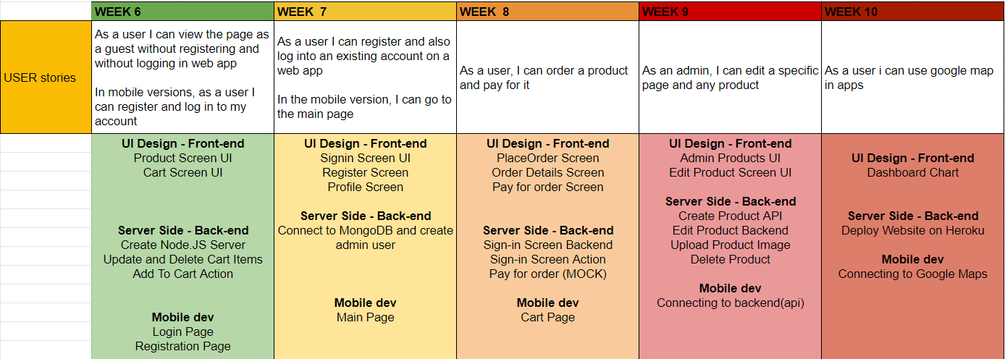
Roadmap

Slide 10
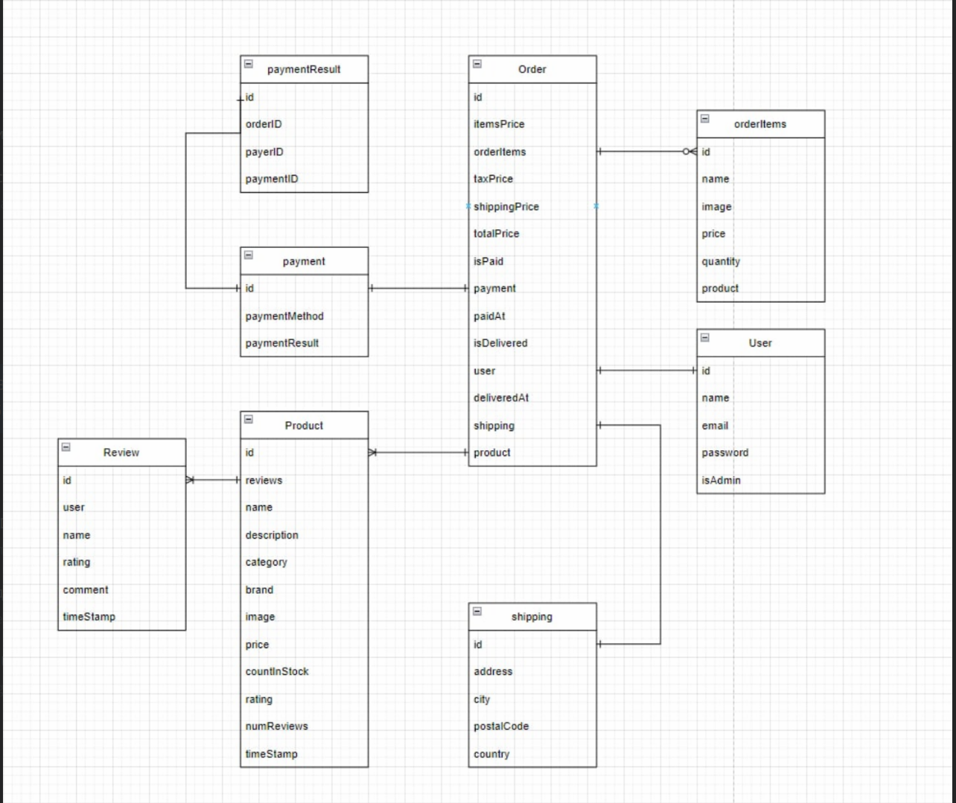
ERD

Slide 11
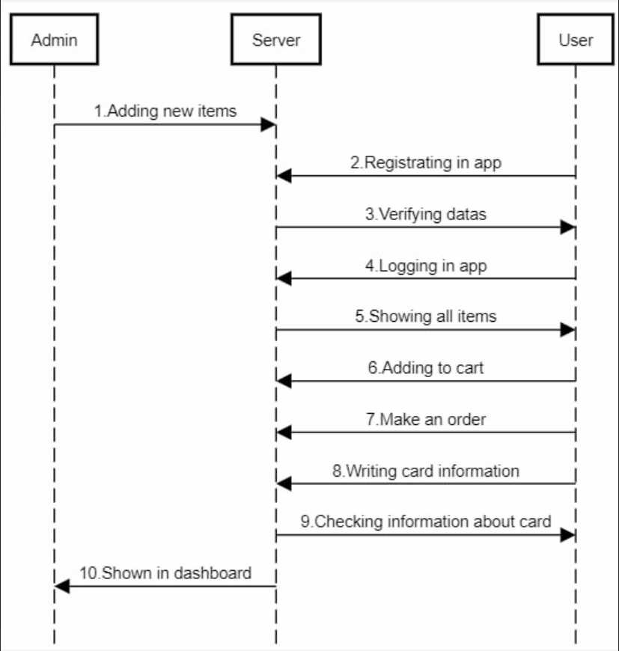
Sequence diagrams

Slide 12
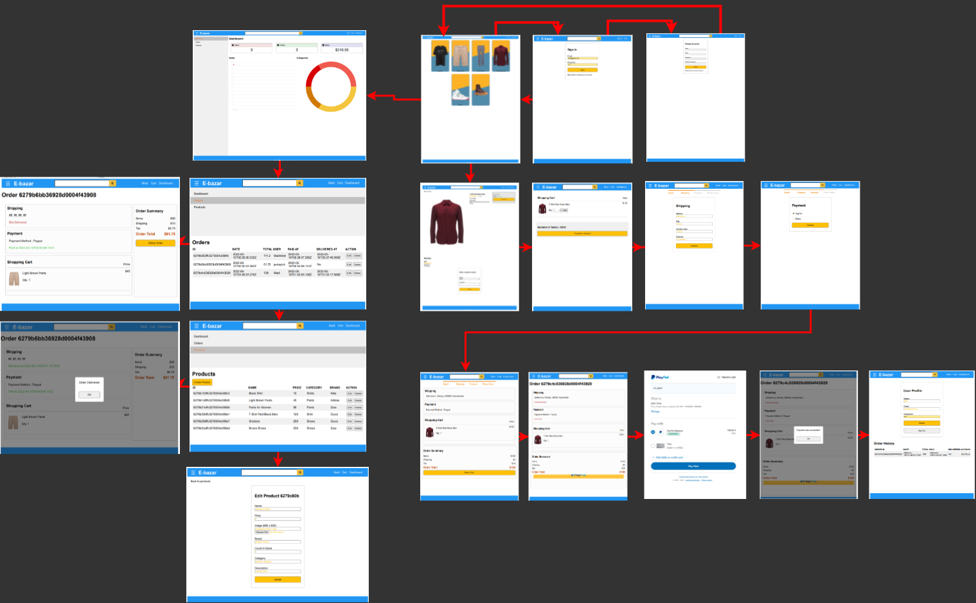

Slide 13
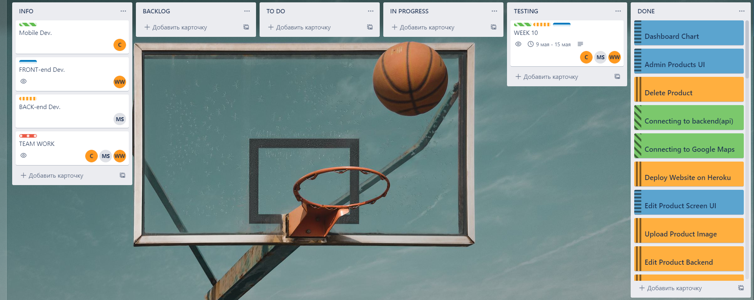
Result
PLAN | Trello

Slide 14
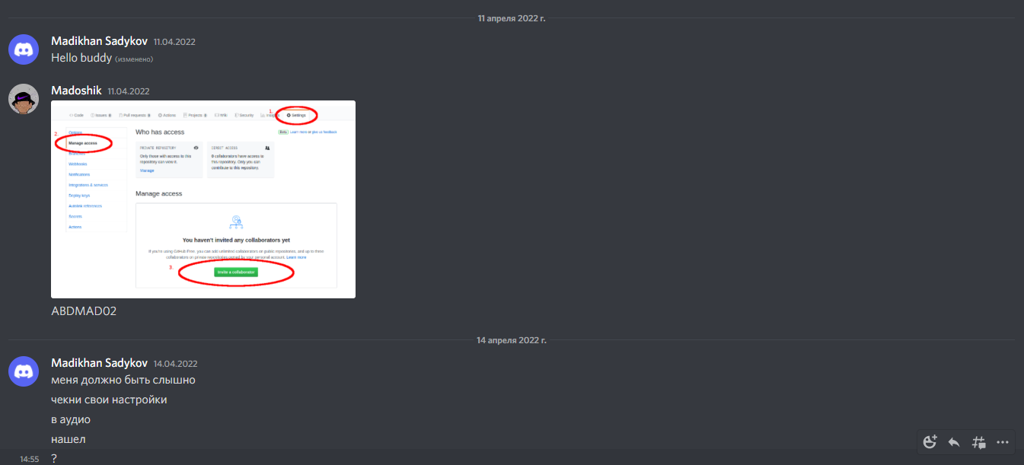
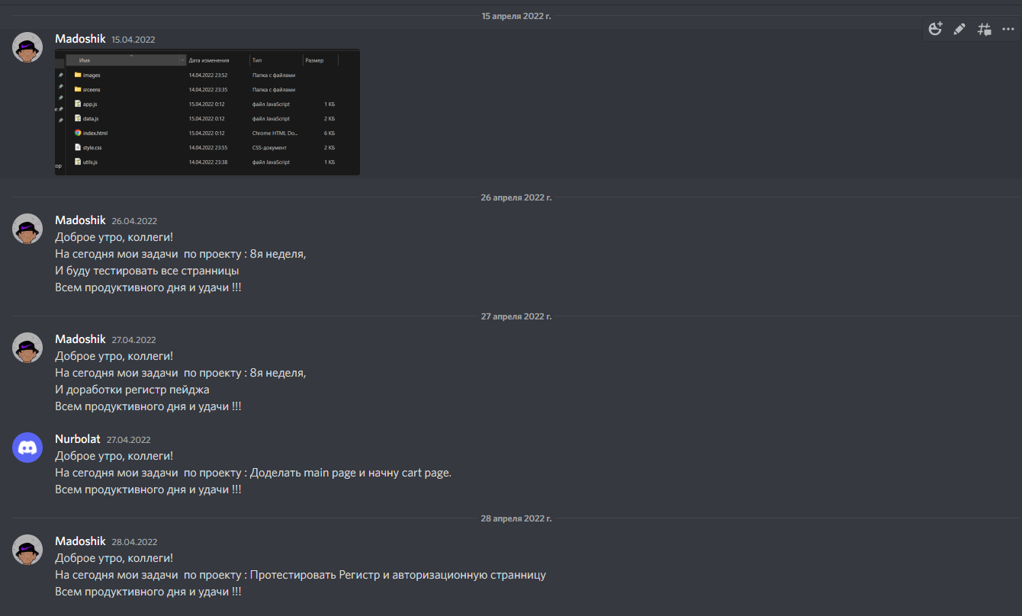
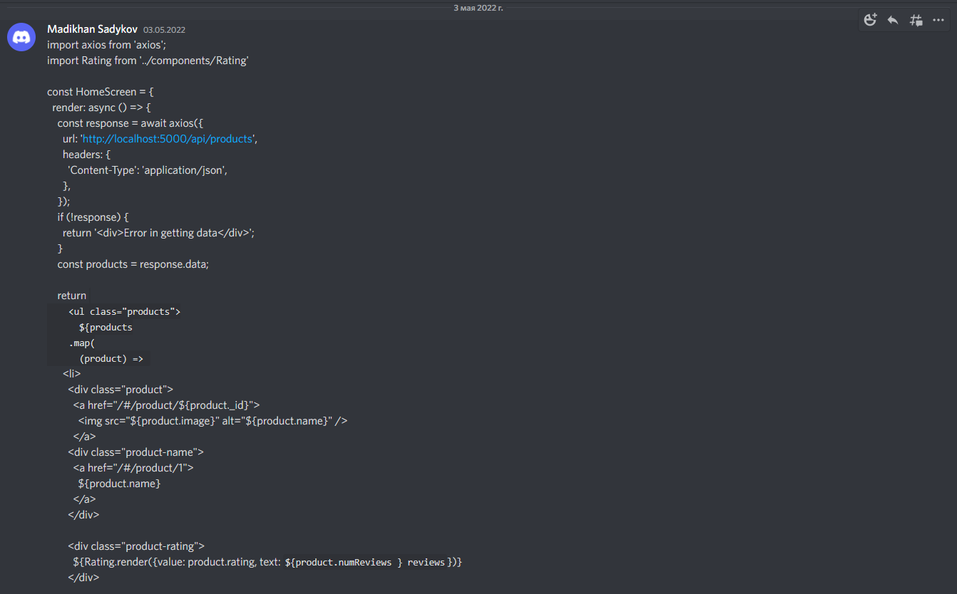
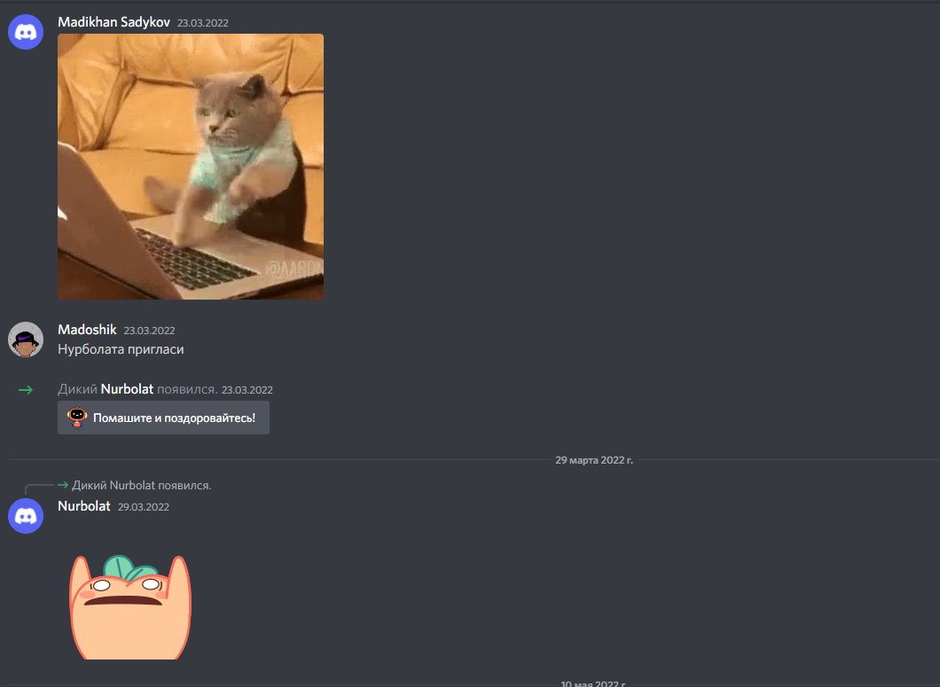
Weekly meetings

Slide 15
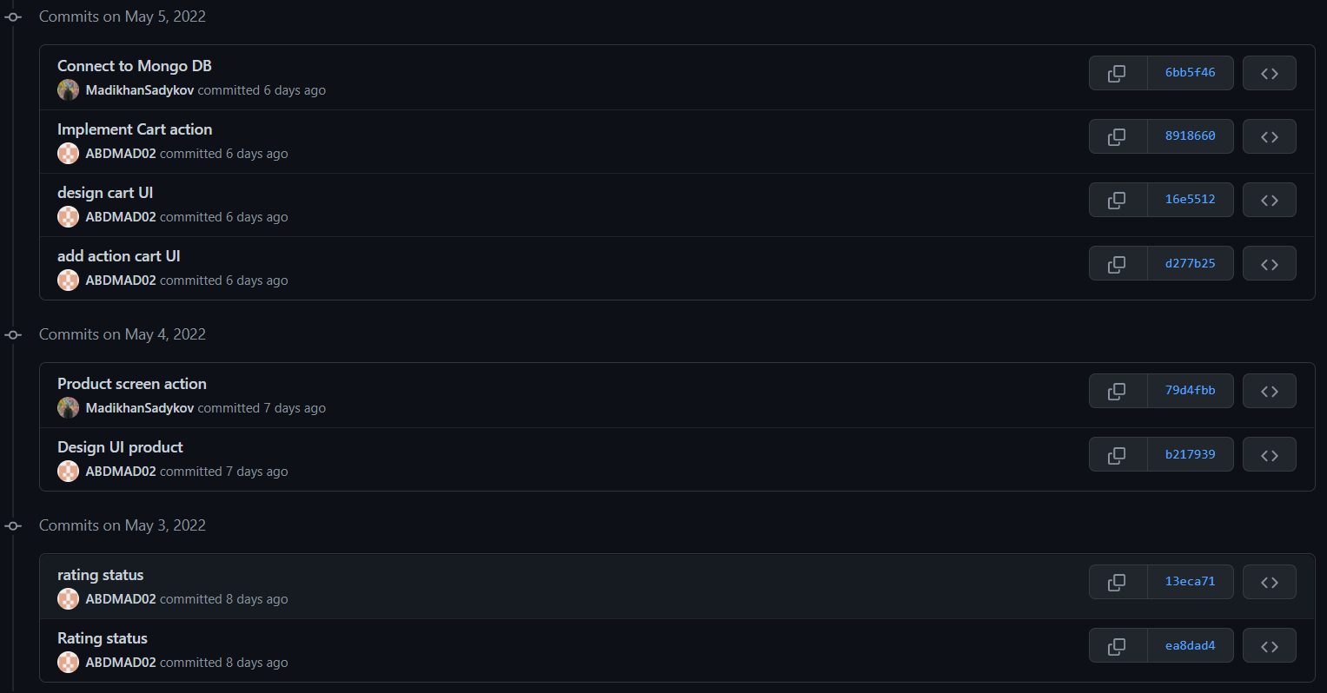
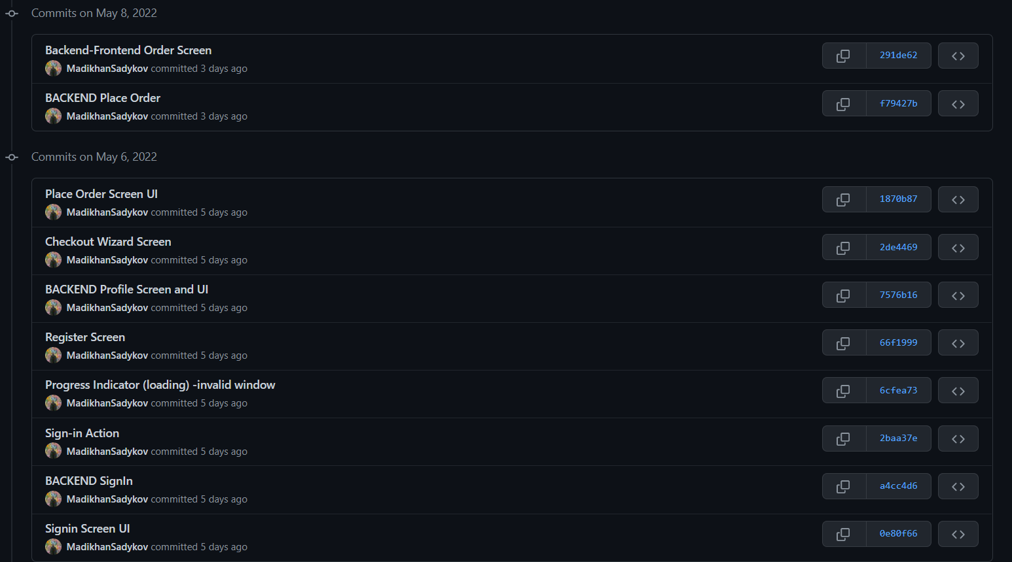
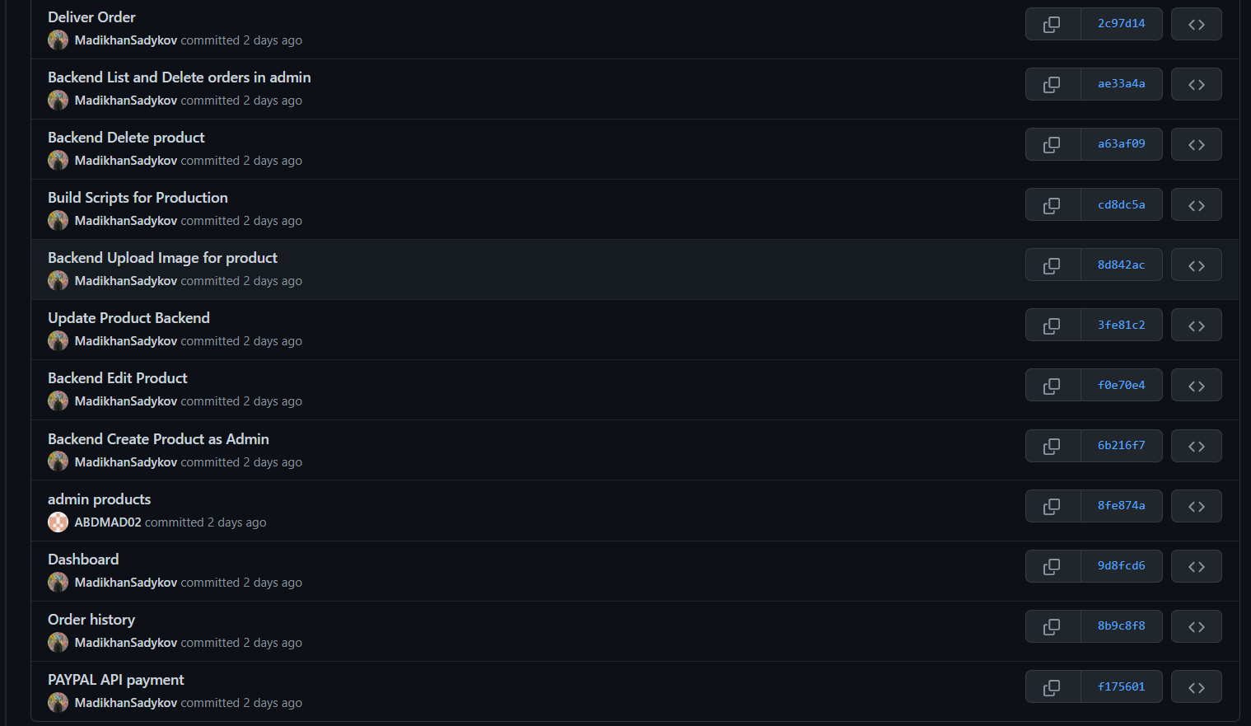
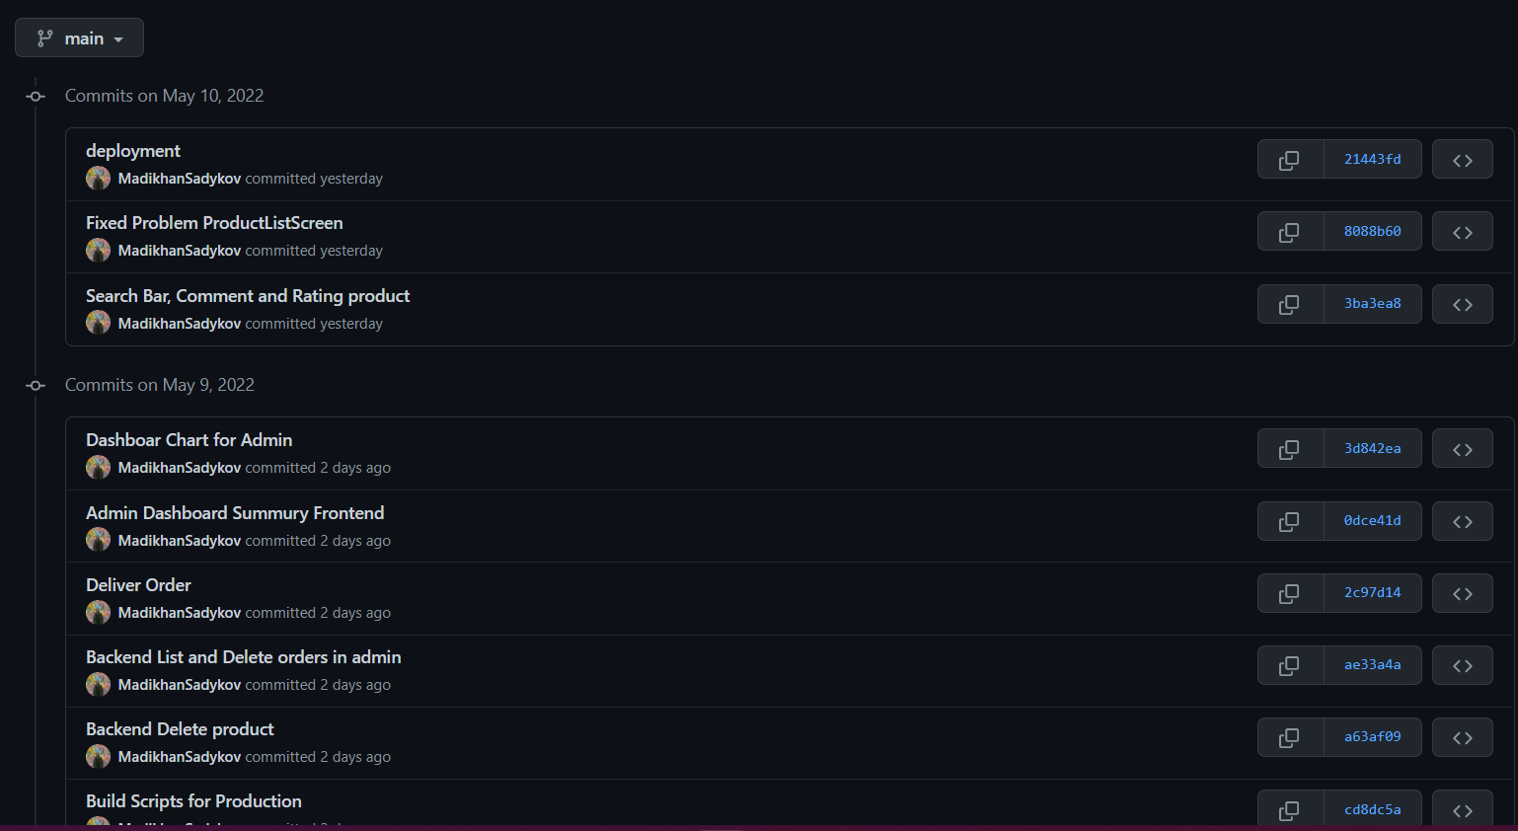

Slide 16
Risk tasks
Fetching data from nodejs api
Import the http package
Make a network request using the http package
Convert the response into custom Dart object
Display the data in a suitable format
Working with google maps
Get an API key at https://cloud.google.com/maps-platform/. Enable Google Map SDK for each platform.

Slide 17
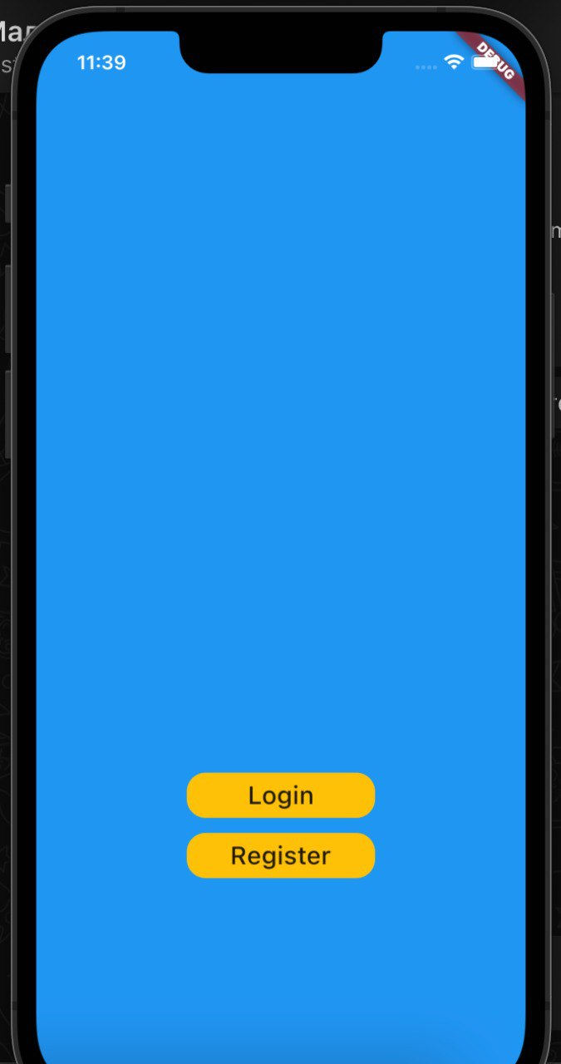
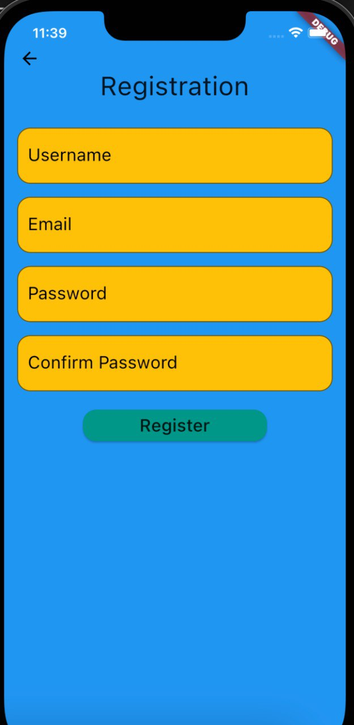

Slide 18
Outcome
Expected: well-coordinated teamwork.
Planned: to complete the project successfully.
It turned out: to implement the project according to the tasks set.
Learned:
● work in a team;
● agile methodology;
● connect web applications with mobile
● work with github in a team
● deploy to the cloud

